Slide 1
Statistical Analysis of Ebola Disease 2014-2016 Outbreak
DIVYANSH CHOUBISA
BACHELORS OF TECHNOLOGY - Computer Science
17BCON393
JECRC UNIVERSITY, JAIPUR

Slide 2
What is ebola ?
Ebola is a dangerous virus that causes severe bleeding, organ failure and can lead to death.
There is no cure or specific treatment for the Ebola virus disease that is currently approved for market, although various experimental treatments are being developed. For past and current Ebola epidemics, treatment has been primarily supportive in nature.
From 2014 Ebola starts to spread in many countries of Western Africa and world causing a tremendous loss of lives of people. Many people died due to this deadly disease and there is still no perfect vaccine for this disease (April,2020).

Slide 3
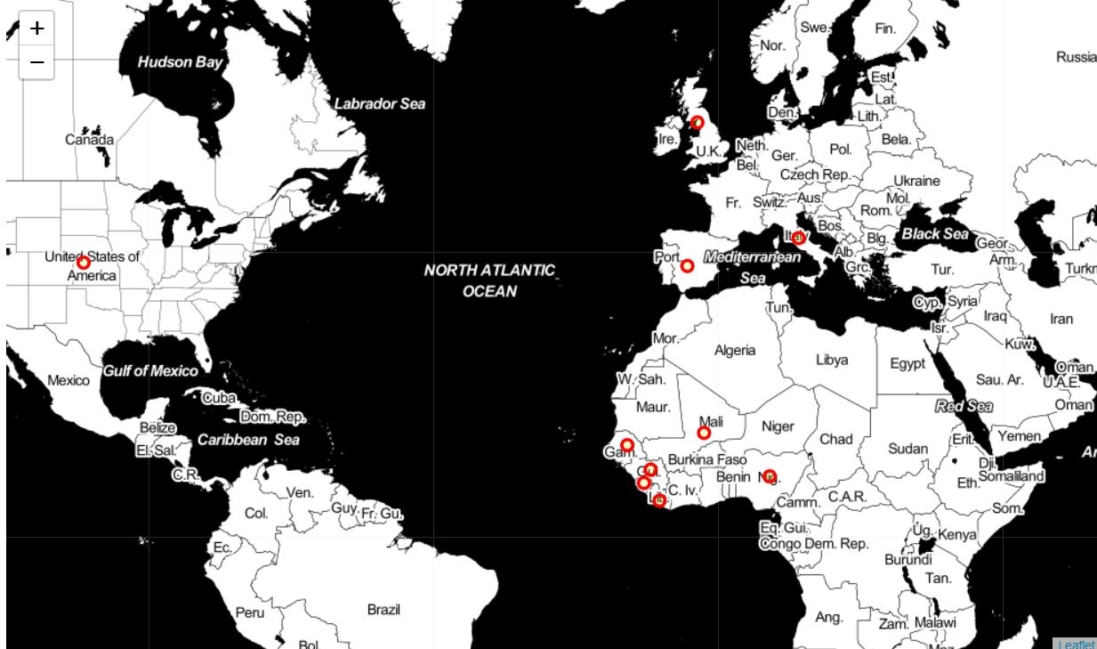
The main countries in world which were affected by ebola 2014-2016 outbreak
These countries were:
Guinea
Nigeria
Sierra Leone
Liberia
Senegal
United States of America
Spain
Mali
United Kingdom
Italy

Slide 4
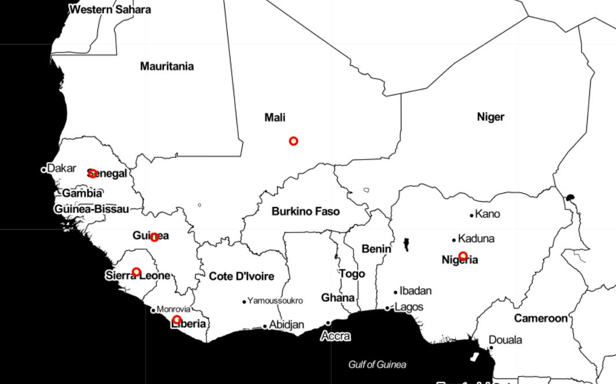
Major west African countries
The major West African countries were:
Guinea
Nigeria
Sierra Leone
Liberia
Senegal
Mali

Slide 5
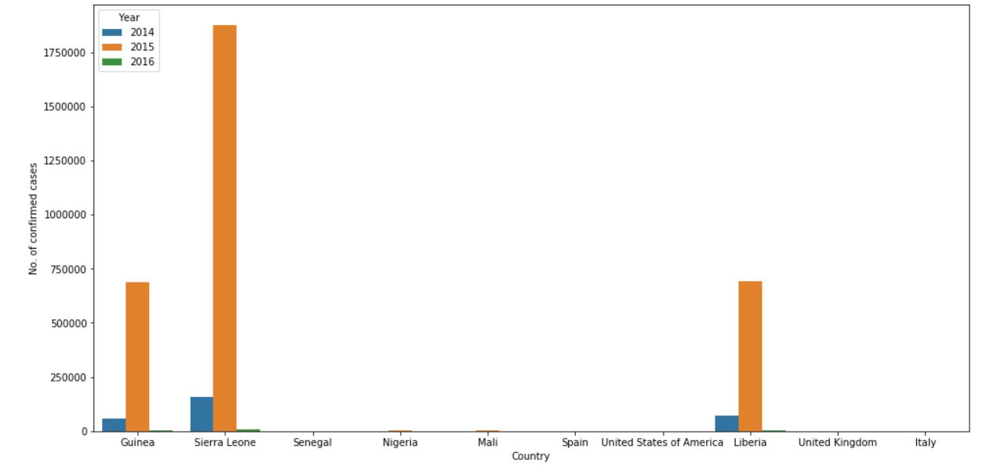
Number of confirmed cases in different countries
The highest number of Ebola confirmed cases were found in mainly 3 countries and these countries were Guinea, Sierra Leone and Liberia.
2015 was the year when there were most cases confirmed in all countries.
Highest number of cases were recorded in 2015 Sierra Leone over 17,50000 i.e. 17 - lakh 50 thousand.
So, the main conclusion we can draw here is that Guinea, Sierra Leone and Liberia were most affected by the Ebola and were most dangerous to live.

Slide 6
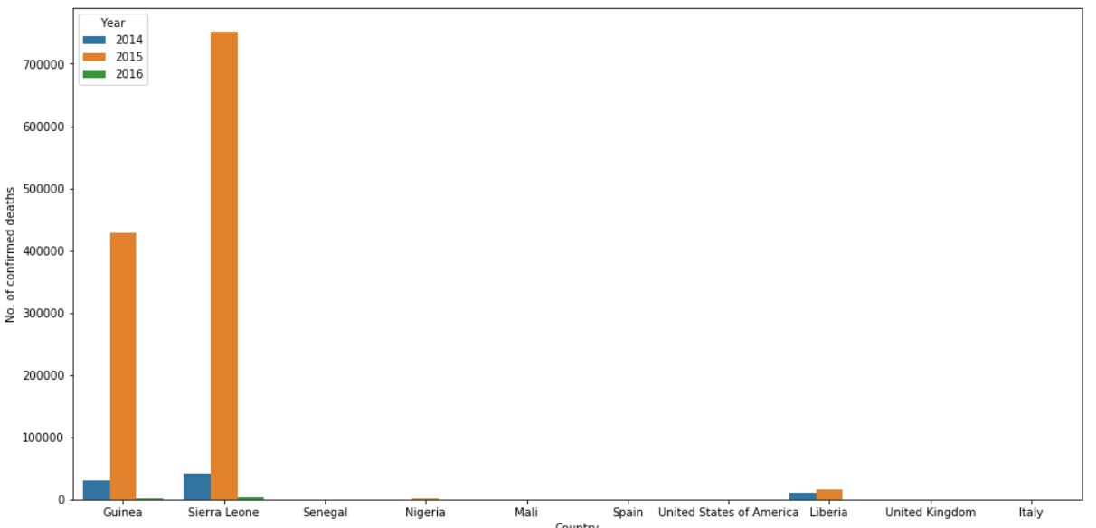
NUMBER OF CONFIRMED DEATHS IN DIFFERENT COUNTRIES
As there were highest number of cases recorded in 2015 in mainly 3
countries Guinea, Sierra Leone and Liberia there were most confirmed
deaths occurred in these countries in same year.
In 2015 there were more than 7,00,000 confirmed deaths because of
Ebola in Sierra Leone.
The greatest number of deaths occurred in Guinea, Sierra Leone and
Liberia.

Slide 7
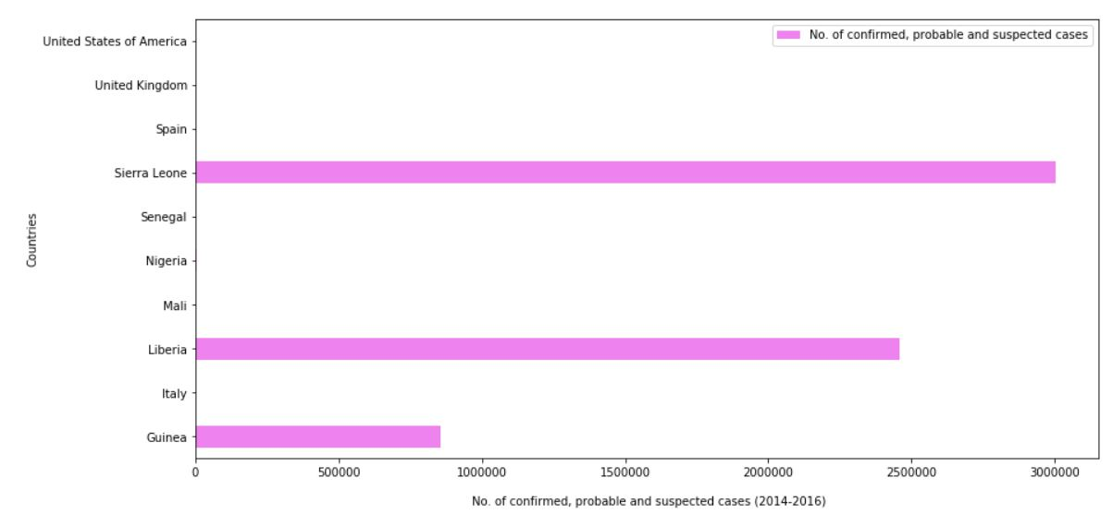
All Kinds of Cases in Different Countries
Now this graph tells us about No. of confirmed, probable and suspected cases
from 2014-2016 in all the different countries.
Here Sierra Leone has maximum number of cases which are 30,03,428 i.e. 30
lakh, 3 thousand 4 Hundred, twenty-eight cases.

Slide 8
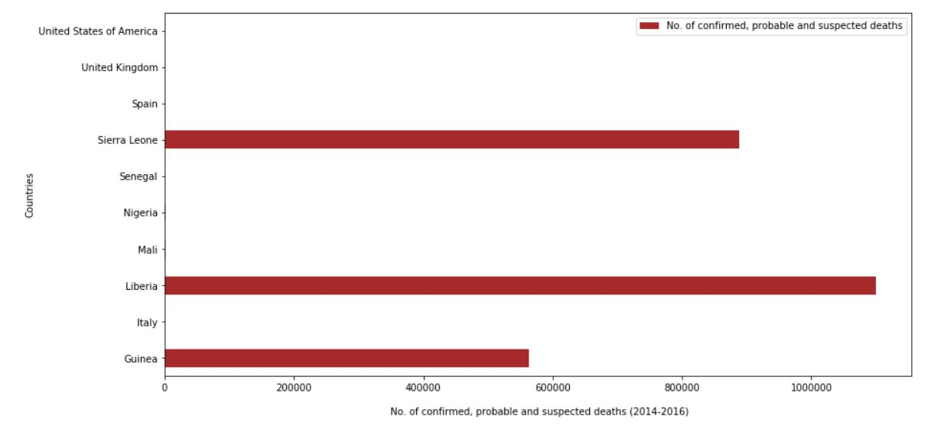
All Kinds of Deaths in Different Countries
The graph generated is telling that Liberia has
highest amount of
No. of probable, suspected and confirmed deaths from 2014-2016
i.e. 10,99,833 i.e.
10 Lakh ,99 Thousand ,8 Hundred, thirty-three deaths.

Slide 9
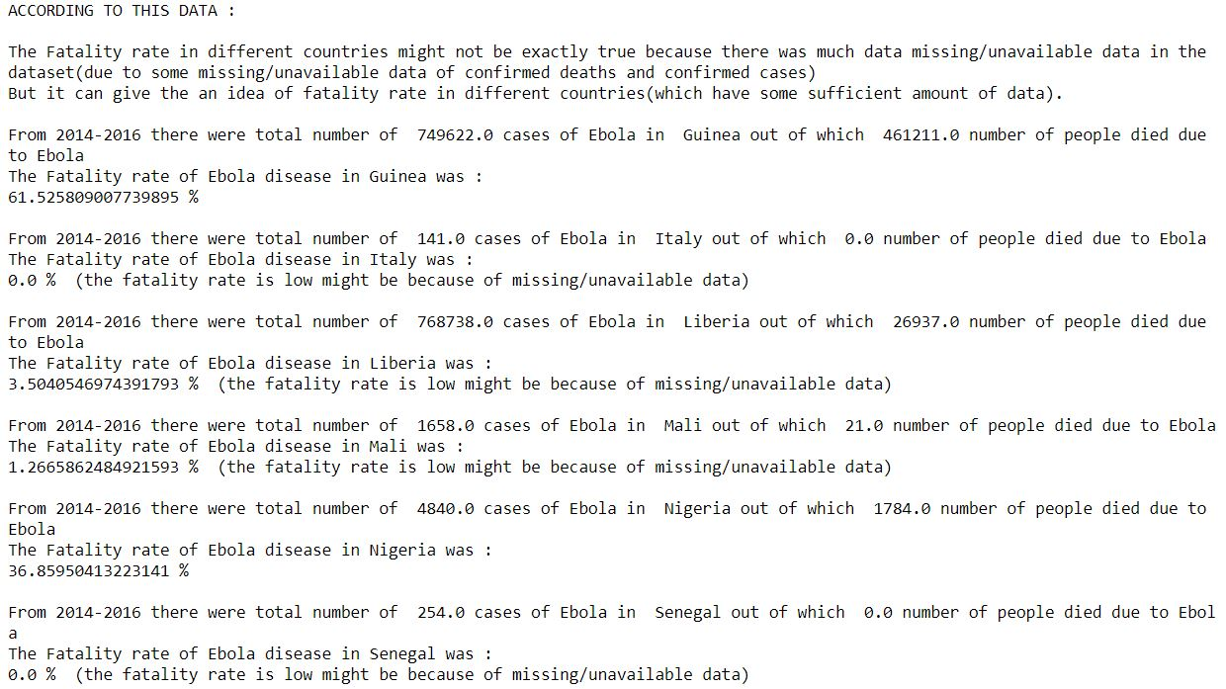
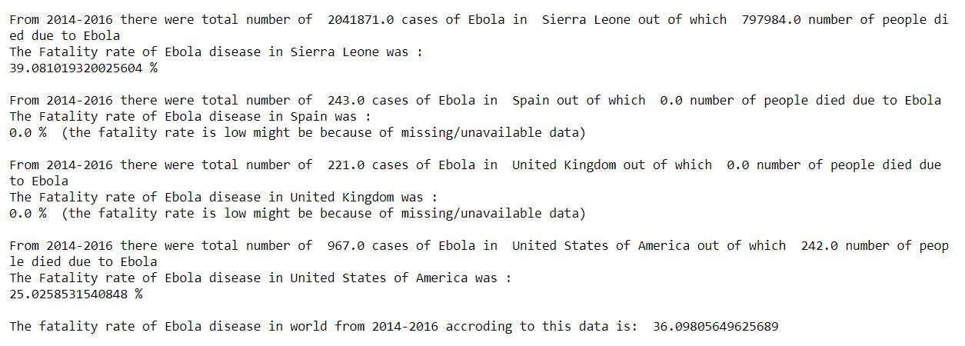
Fatality Rate Calculation
The fatality rate of Ebola in Sierra Leone was 39.0810 %
Of Guinea was 61.5258 %
And of Liberia was 3.5040 % which is quite odd as we compare it to other countries as there is no perfect vaccine/cure for Ebola which simply mean that there was some missing/less data of confirmed deaths.
There is also a possibility that the data recorded was more of probable and suspected deaths than confirmed deaths. It might happen because of the unstable situation that is created in a country when it is facing such dangerous situation created by a disease.
Anyways we can say that the fatality rate of Ebola is generally very high it can range from 25% - 61% or more (According to data I have worked on).
The Fatality rate of Ebola in Nigeria was also 36.8595%.
The fatality rate of whole world (2014-2016) according to this dataset is
36.0980 %. Definitely there was some missing data which can generate a strong possibility that the fatality rate can higher of this deadly disease than just 36.0980 %.

Slide 10
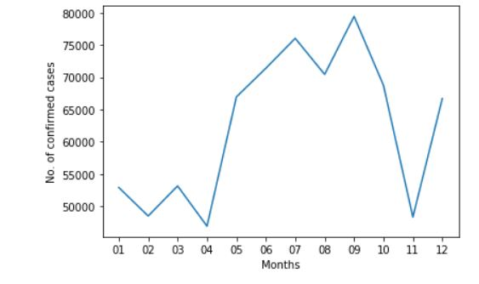
GUINEA
- Now from the previous analysis we saw that the fatality rate of Ebola in Guinea
was 61.52% and there were around 7,49,622 confirmed Ebola cases out of
which 4,61,211 confirmed deaths occurred.
- So, we need to study what happened in Guinea and because of Ebola and
different kind of graphs
From this graph we can observe that there are tremendous number of confirmed
cases of Ebola from May-October and we know that from July to November the
weather of Guinea is Monsoon with a south westerly wind and from December
to May it is Dry Season with north easterly harmattan. So, we can say that in
Guinea Ebola spreads very much in the months of July – October/November
when there is monsoon and cases decreases when dry season came from
December to May.

Slide 11
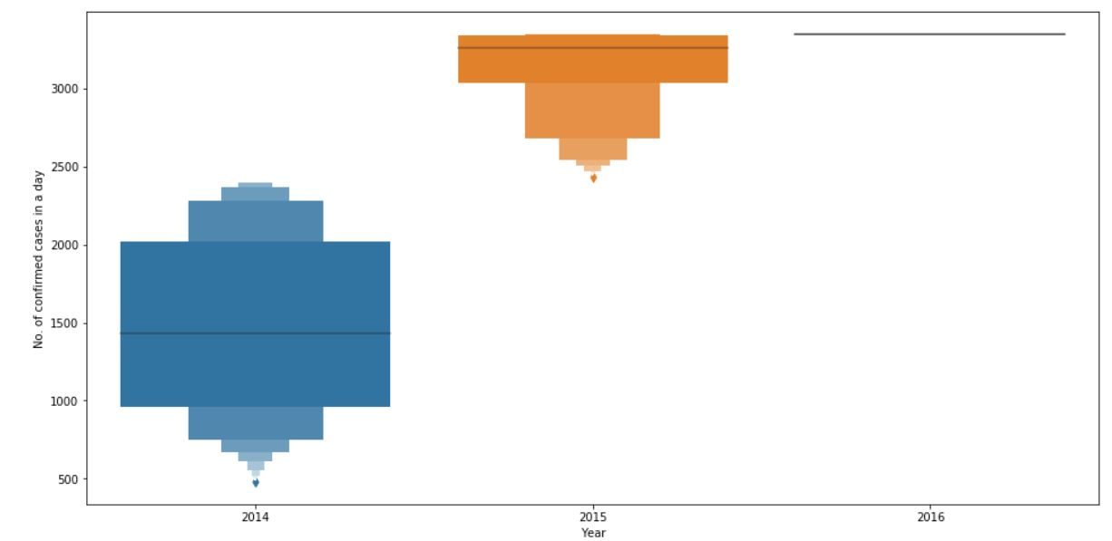
No. of Confirmed Cases in a Day (Guinea)- Letter Value Plot
The figure is showing the number of confirmed cases in a day by Ebola
in different years in Guinea.
In 2014 the 25th percentile of data is very near to 1000 and the 75th percentile is
near around 2000 in 2014 which means in the throughout the 2014 more than
1000 or more than 1000 confirmed cases were getting in a day 75% of the time.
And similarly
25 % of the time there were 2000 or more than 2000 confirmed cases were
getting in a day in Guinea.
These numbers are so much high in 2015 that 50% of the time there were more
than 3000 confirmed cases in a day.

Slide 12
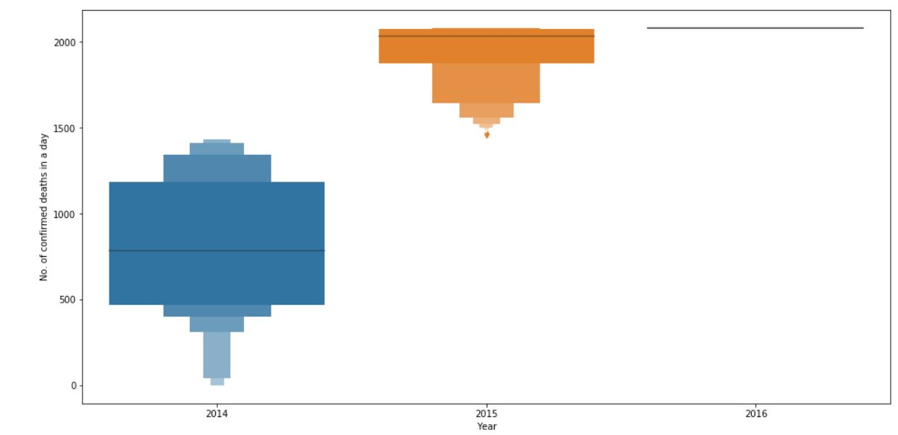
No. of Confirmed Deaths in a Day (Guinea)- Letter Value Plot
The figure is showing the number of confirmed deaths in a day by Ebola in different years in Guinea.
In 2014 the 25th percentile of data is around 500 and the 75th percentile is more than 1100 in 2014 which means in the throughout the 2014, 500 or more than
500 confirmed deaths were occurring in a day 75% of the time. And similarly
25 % of the time there were more than 1100 confirmed deaths were occurring in
a day in Guinea.
These numbers are so much high in 2015 that 50% of the time there were near
around 2000 confirmed deaths in a day.

Slide 13
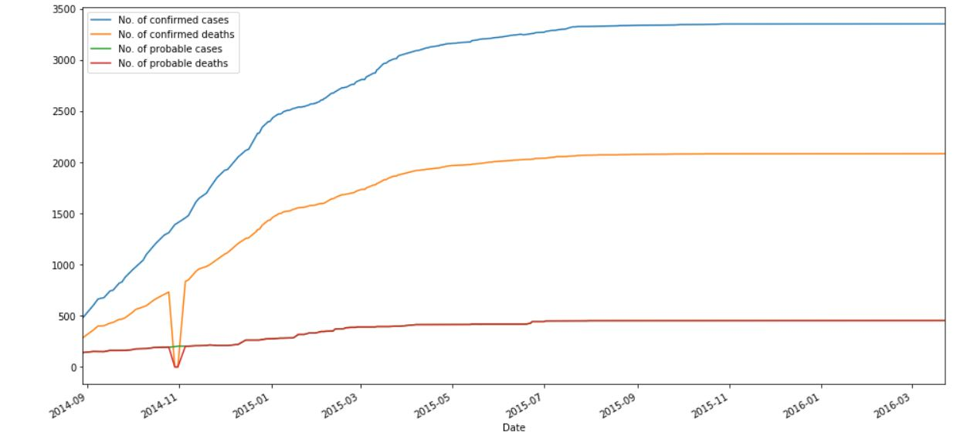
Guinea- Line Graph for Different Kind of Cases and Deaths
This graph is showing the time line from 2014-2016 with different lines showing number of confirmed cases and deaths and number of probable cases and deaths.
In the line graph of number of confirmed deaths there is an outlier on the point
near 2014-11 because of missing data being replaced with 0 value. Else whole
graph is very clear.
We can say that number of confirmed cases were increasing from 2014 to 2016
and takes a constant rate of growth. We also know that the fatality rate of Ebola
in Guinea was 61.525 % and that difference can be seen in the line of number of
confirmed cases and number of confirmed deaths.

Slide 14
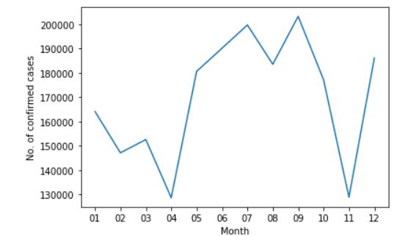
SIERRA LEONE
During our analysis we found that the fatality rate of Ebola in Sierra Leone
39.0810 %. There were total 2041871 confirmed cases of Ebola and 797984
confirmed deaths occurred.
So, we need to study what happened in Sierra Leone and because of Ebola and
different kind of graphs
This graph is showing No. of confirmed cases of Ebola in different months of a year.
From this graph we can understand that from May to October there are tremendous amount of confirmed cases of Ebola. These cases have decreasing behaviour from the months of January to April.
In Sierra Leone there is rainfall from June to November which might be the cause of high number of confirmed Ebola cases while from December to February there is Dry, Dusty and Harmattan wind blows from Sahara and in March there are sporadic rainfalls (occasional).
So, we can say that during rainfall and wet humid environment the probability of Ebola to spread is very high in Sierra Leone.

Slide 15
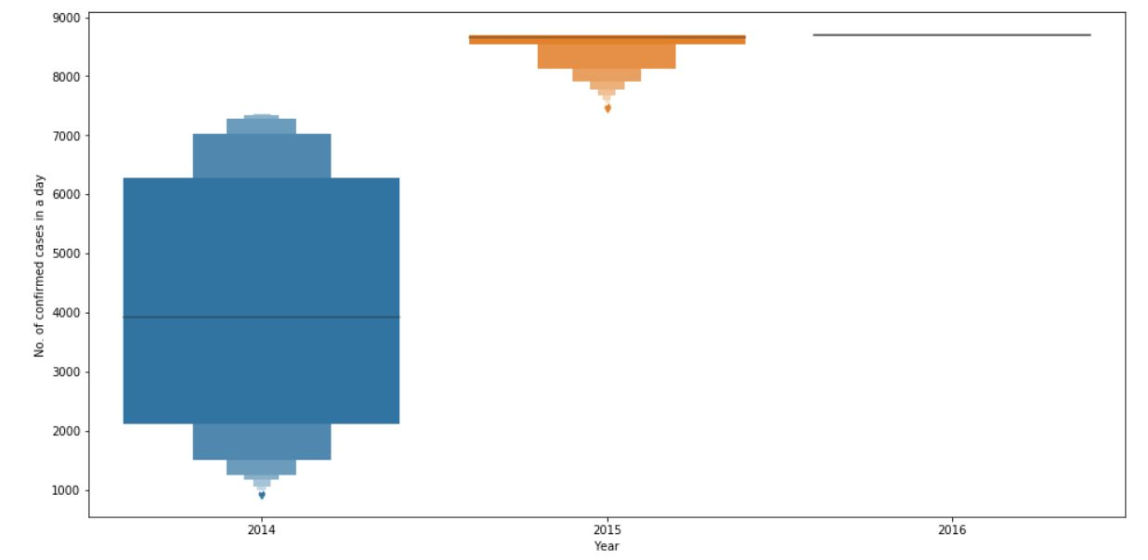
No. of Confirmed Cases in a Day (Sierra Leone)- Letter Value Plot
The figure is showing the number of confirmed cases in a day by Ebola in different years in Sierra Leone.
In 2014 the 50th percentile of data is around 4000 and the 75th percentile is more than 6000 in 2014 which means in the throughout the 2014, near around 4000 or more than 4000 confirmed cases were occurring in a day 50% of the time. And similarly 25 % of the time there were more than 6000 confirmed cases were getting in a day Sierra Leone.
These numbers are so much high in 2015 that 50% of the time there were near around 8500 confirmed cases in a day.

Slide 16
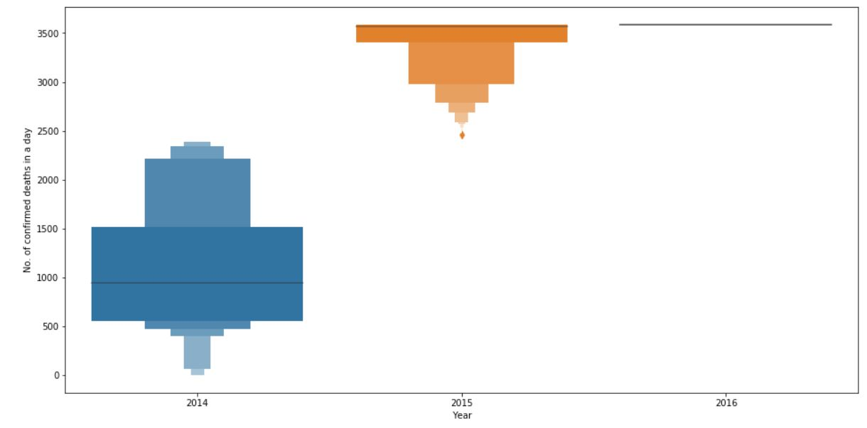
No. of Confirmed Deaths in a Day (Sierra Leone)- Letter Value
Plot
The figure is showing the number of confirmed deaths in a day by Ebola in different years in Sierra Leone.
In 2014 the 50th percentile of data is more than 900 and the 75th percentile is around 1500 in 2014 which means in the throughout the 2014, near around 1000
or more than 900 confirmed deaths were occurring in a day 50% of the time. And similarly
25 % of the time there were more than or equal to 1500 confirmed deaths were getting in a day Sierra Leone.
These numbers are so much high in 2015 that 50% of the time there were near around 3500 confirmed deaths in a day.

Slide 17
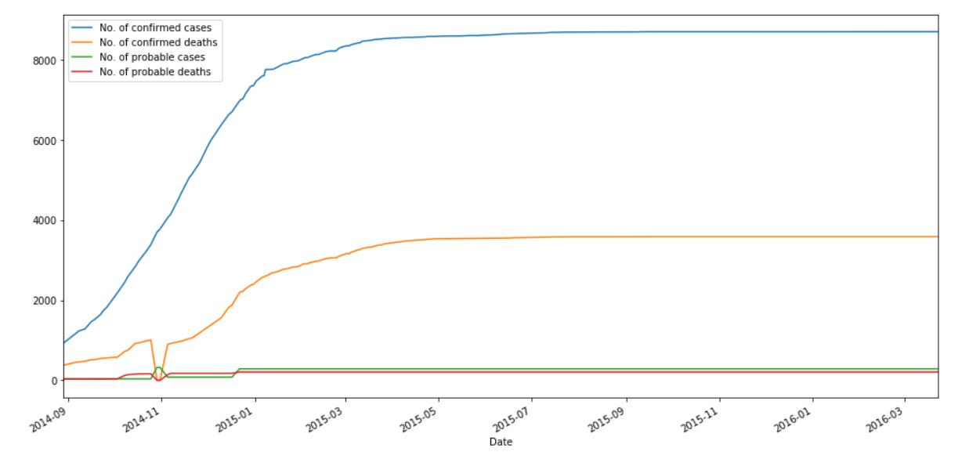
Sierra Leone -Line Graph for Different Kind of Cases and Deaths
This graph is showing the time line from 2014-2016 with different lines showing number of confirmed cases and deaths and number of probable cases and deaths.
In the line graph of number of confirmed deaths there is an outlier on the point
near 2014-11 because of missing data being replaced with 0 value. Else whole
graph is very clear.
We can say that number of confirmed cases were increasing from 2014 to 2016
and takes a constant rate of growth. We also know that the fatality rate of Ebola
in Sierra Leone was 39.0810 % and that difference can be seen in the line of
number of confirmed cases and number of confirmed deaths.

Slide 18
THE END

